Slide 1
Proportionality as the Core Principle of the Supervision of a Heterogeneous Banking Sector
Lessons Learned From Germany with an heterogeneous banking sector of roughly 2,000 banks
Dirk Kramer
Federal Financial Supervisory Authority (Germany)
(Bundesanstalt für Finanzdienstleistungsaufsicht; BaFin)
EBA Workshop „The application of proportionality measures in the EBA‘s regulatory work“
London, October 22 2013

Slide 2
Proportionality / Regulation & Supervision (I)
  Background
    Heterogeneity of the German financial system (roughly 2,000 institutions varying by size, complexity, business model, etc.)
    Our understanding of Pillar 2 requirements
      Qualitative proportional requirements
      Focus on organisational structures & processes
      Recognition as a management tool for banks
    Long-term experience with qualitative supervision

Slide 3
Proportionality / Regulation & Supervision (II)
  Concept of Proportionality within Pillar 2 regulation &
  supervision
    Can we precisely (and practically) define proportionality? Do we need clear-cut thresholds resulting in automatism? → appealing but have their drawbacks
    Alternative concept: principle based regulation with a “basic rulebook”
      Wide scope: for all credit institutions and investment firms
      Comprehensive: addresses main risk management issues (requires only few further regulations/guidelines)
      Banks are responsible for the implementation depending on nature, scale and complexity of the banks and their activities
      In Germany: the Minimum Requirements for Risk Management (MaRisk) ≈ EBA GL 44 + few further issues

Slide 4
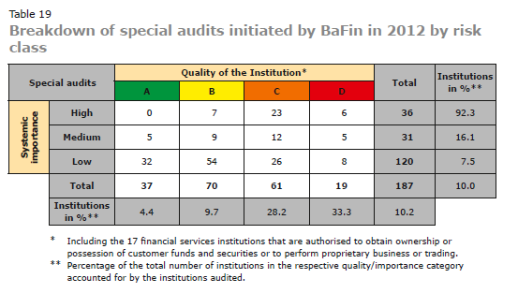
Categorisation & On-site Inspections in 2012
Source: BaFin. Annual Report 2012 (Table 19/p. 141)

Slide 5
Our Recommendation
      We should further elaborate the
      EBA Guidelines on Internal Governance (GL 44)
      as the central basis of Pillar 2 requirements
      within the European Single Rule Book!
      More granularity (not rule based)
      A flexible guideline for categorisation with case-by-case decisions
      Integrate other guidelines, i.e. increasing the scope

Slide 6
Thank you very much
for you attention
Dirk Kramer
Dirk.Kramer@bafin.de
(Section BA 54: BA54@bafin.de)

Slide 7
Appendix I: Supervision Pyramid
Final responsibility for prudential supervision by BaFin, in close cooperation with Deutsche Bundesbank
special audits (sect. 44 Banking Act) by Deutsche Bundesbank and external auditors
Internal controls and risk management
of the institutions
Off-site supervision by using various information sources for daily supervision and risk assessment; including the auditors long form report as a central element
It is the task of supervisors to challenge institutions on a case-by-case basis to implement the requirements – with MaRisk as the benchmark.

Slide 8
Appendix II: Modular Structure of MaRisk
General Requirements
Issues such as: internal capital adequacy process (ICAAP), risk-inventory,
strategies, documentation, stress testing, human- and technical resources,
outsourcing, activities in new products/markets, …
Special Requirements for the Internal Control System
Requirements for the structural and operational arrangements
Requirements for processes for risk
control:
Lending business
Trading business
Counterparty risk
Market price risk
Liquidity
risk
Operational risk
Special Requirements for the Internal Auditing Function

