Slide 1

EBA Proportionality Workshop – Leverage Ratio
Jesper Berg
Senior Vice President, Nykredit

Slide 2
Rationale of leverage ratio and risk-based measures
Leverage ratio
  Measures the extend to which a given portfolio of assets is supported by capital
Risk-based capital adequacy ratios
  Assess whether the level of capital is adequate to cover portfolio losses
Regulatory proportionality:
“… the principle of proportionality, having regard in
particular to the diversity in size and scale of operations and to the range of activities of
institutions…
… proportionate to the nature, scale and
complexity of the risks associated with an institution's business model and activities…”
CRR, recital 46

Slide 3
Speciality vs. riskiness
Business model
Hypothekenbank (DE)
Specialized entity
Hypotekbank (SE)
Realkreditinstitutter (DK)
Société de crédit foncier (FR)
Full service entity
High risk (unsecured)
Low risk (mortgages, public sector)
Lending products

Slide 4
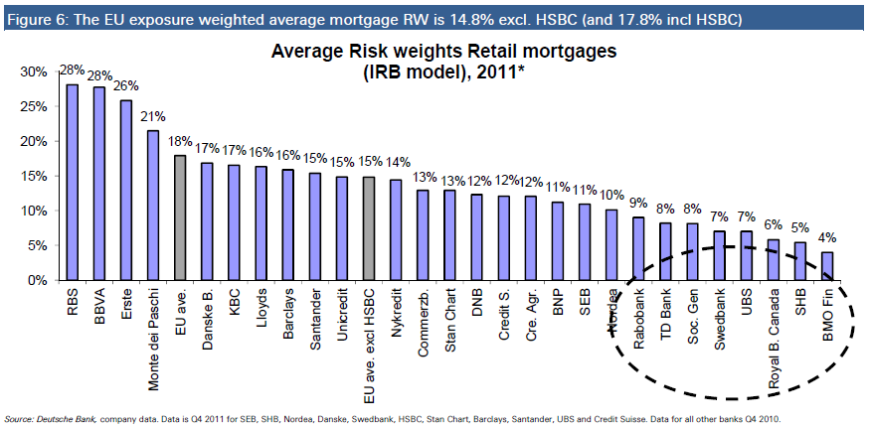
Low risk lending (e.g. mortgage lending) …

Slide 5
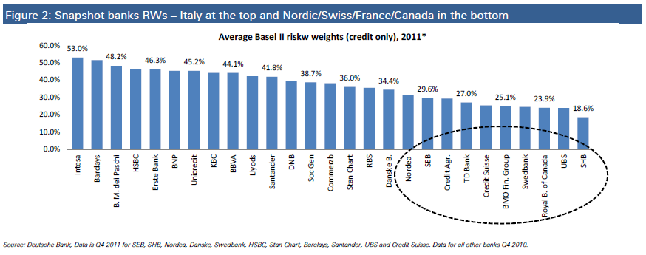
… can actually reflect low risk business model
Nykredit

Slide 6
Low risk business models is in fact low risk!

Slide 7
Full service vs. specialized entities
Assets Liabilities
Assets Liabilities
Loans
Deposits
Loans
Bonds
Liquidity
Capital
Liquidity
Capital
Mix of secured an unsecured lending
Growth can be funded by a vide range of funding instruments
Deposits can run
Only secured specialized lending
Special debtor rights and liabilities
Growth can only be funded by special funding instruments
Bonds can’t run
Special ALM framework

Slide 8

Charateristics of the Leverage Ratio
One-size-fits-all measure
Uniform treatment of balance sheet risks, i.e. hedge fund investments is equalized with fully secured mortgage lending
Simplicity vs. risk sensitivity and comparability
Incentive for higher risk lending and produce adverse effects for conservative business models, i.e. drives low risk mortgage lenders into riskier businesses with a significant cost impact for consumers
Proportionality issues
  Possibly the main binding constraint for low-risk business models – not a backstop
  Legal structure and specialized banks
Easy to apply but at the expense of an un-level playing field?

Slide 9
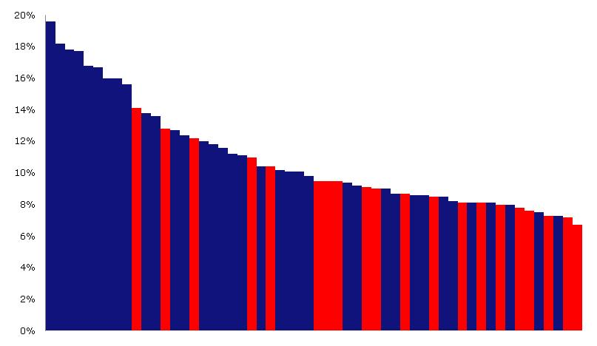
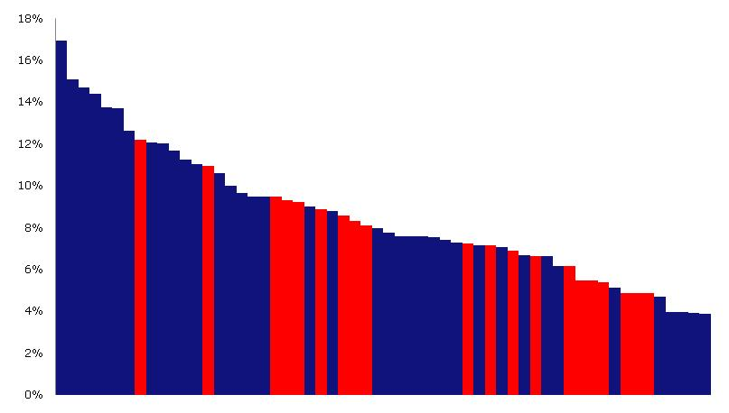
Early warning indicators for 58 Danish banks
Is the leverage ratio a superior early-warning indicator as proposed by the Bank of England?
Not on Danish data, cf. Berg et al. (2013)
The best early-warning indicators for Denmark:
  Sum of large exposures
  Property exposure
Haldane’s analysis subject to the Lucas critique
Tier 1 capital to RWA 2007
Leverage ratio 2007

Slide 10

Proportionality principles based on business model designs
A 3% leverage ratio may not be compatible with low risk business models
Proportionality principles must be introduced to prevent unintended consequences:
  Lending structure
    Specialized low risk lending
    Documented low loss rates
    Modest balance sheet growth
    Level and concentration of exposures
    Debtor rights and liabilities
  Funding structure
    Secured instruments, e.g. covered bonds
    Asset-liability management, e.g. pass-through systems
    Acceptance of lower leverage ratios for certain business models, or
    Partly risk-weighting on uniform leverage ratio limit
House loan
Debt

Slide 11
The Danish case: Specialized mortgage banks
Low-risk and high volume
Funded entirely by covered bonds with a direct claim on underlying assets
Professional and informed investors – no simple depositors
Solid track record during the financial crisis
Personal liability
Strict ALM – pass-through system

Slide 12
The Danish case cont’d
– differentiate between commercial banks and mortgage banks
Recommendations by the Government appointed ”Financial Crisis Committee” that launched its report 18 September 2013:
”The Committee recommends setting up a group of experts to assess whether the general leverage ratio should be higher than the 3 percent requirement on which the Basel III standards are based. The expert group must assess whether the general leverage ratio limit should be different for banks and mortgage credit institutions and for banks that use, respectively do not use internal models.”
“The Committee recommends that the FSA prepares a "Supervisory Diamond" that is particularly aimed at mortgage credit institutions.”

Slide 13
Possible two-dimensional solution
Business model
Specialized entity
Combination
1
3
Non-uniform leverage ratios
Full service entity
Partly risk-weighted uniform leverage ratio
2
High risk (unsecured)
Low risk (mortgages, public sector)
Lending products

Slide 14
Summing up
Proportionality in regulation must be applied
Low risk weights can actually reflect low risk business model (specialized low risk lending)
Leverage ratio not predictive as an indicator of early warning
  If so then only at a global level
Possible two-dimensional solution

