Slide 1
2018 EU–wide Stress Test Results 02 November 2018

Slide 2
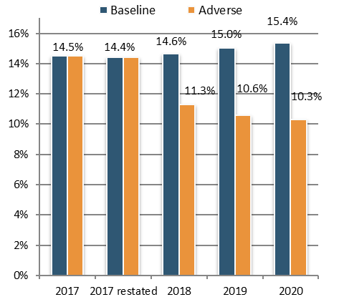
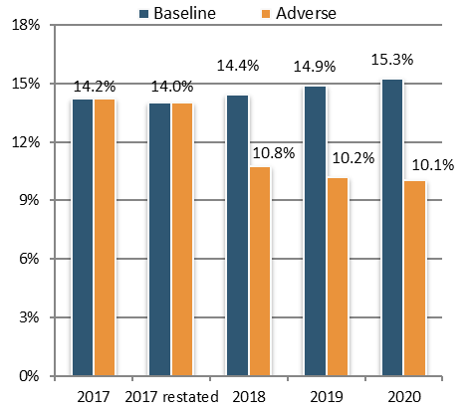
2018 ST results – Impact on EU aggregate CET1 ratio
Transitional – starting point 14.5%
Fully loaded – starting point 14.2%
IFRS 9 first implementation: -10bps
Stress test impact: -410bps
Capital depletion: €236bn
Increase of total REA: €1055bn
IFRS 9 first implementation: -20bps.
Stress test impact: -395bps
Capital depletion of €226bn
Increase of total REA: €1049bn
* All impact figures in bps shown in the text are rounded to the nearest 5bps

Slide 3
Bank-by-bank impact, order by size of transitional impact
The impact of the stress test on transitional CET1 capital ratio varies significantly across banks, ranging from a minimum decrease of -50 bps to a maximum decrease of -780 bps.
25% of the banks report a decrease above 530bps, with another 25% of banks reporting a decrease below 285bps.

Slide 4
Bank-by-bank impact, order by size of FL impact
The impact of the stress test on FL CET1 capital ratio also varies significantly across banks, ranging from a decrease of -30 bps to a maximum decrease of -770 bps.
25% of the banks report a decrease above 525bps, with another 25% of banks reporting a decrease below 270bps.

Slide 5
Bank-by-bank CET1 ratio, starting and end point (%)
Large dispersion also of banks’ capital position at the starting and end-point. CET1 ratios range from 11.6% to 41.7% on a transitional basis (10.8% to 41.6% on a fully loaded basis) at the end of 2017 (non-restated) and from 7.1% to 34% on a transitional basis (6.4% to 34% on a fully loaded basis) at the end-2020 adverse scenario.
All banks report minimum levels of transitional capital ratios above Pillar 1 capital requirements, with a transitional CET1 capital ratio above 4.5%, a transitional Tier 1 capital ratio above 6% and transitional total capital ratio above 8%. 25 trigger MDA rules.

Slide 6
2018 ST – Impact on leverage ratio (transitional)
Evolution of aggregate leverage ratio (%)
LR dispersion – 5th and 95th percentiles, interquartile range and median in the adverse scenario (%)
Transitional leverage ratio falls from 5.4% in 2017 to 4.4% in 2020 – adverse.
Drop solely due to decreasing T1 capital, as leverage exposure remain constant.
In 2019, adverse scenario, three banks fall below the 3% LR.
In 2018, adverse scenario, two banks report a ratio below the 3% LR.
In 2020, adverse scenario, three banks fall below the 3% LR.

Slide 7
Aggregate waterfall
Credit risk losses
Market risk losses
Op and conduct risk losses
Credit losses have the highest impact: -€358bn, -425bps (-370bps in 2016).
Market risk shock (including OCI): -€94bn, -110bps (-100bps in 2016).
Op. risk: -€82bn, -100bps (‑110bps in 2016), mostly conduct risk, -65bps (‑80bps in 2016).
REAs increase by 12% compared to 2017, with a negative impact on capital of 160bp.

Slide 8
Impact on profitability, aggregate EU level
Cumulative net loss before tax as of end 2020 under the adverse scenario: -€161bn, -190bps.
Lower contribution to capital by -150bps from NII, -80bps from NFCI, and -140bps from NTI due to the stress.
2020 unstressed represents the cumulative contribution of NII, NTI, NFCI and dividend income as if the 2017 figures were kept unchanged.
2020 adverse represents the cumulative contribution of NII, NTI, NFCI and dividend income as of end 2020 under the adverse scenario.

Slide 9
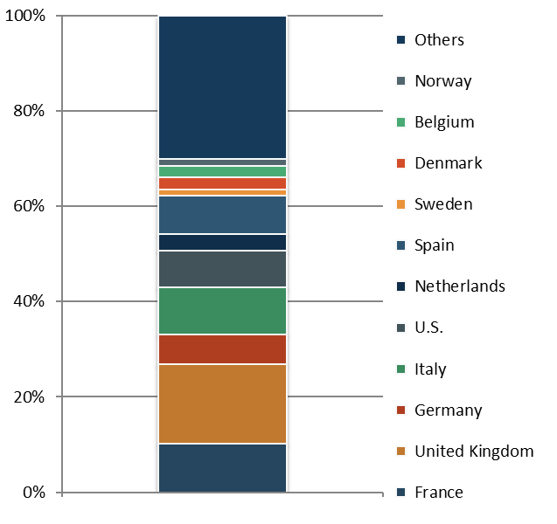
Credit risk losses
Evolution of absolute credit losses (€ bn)
Distribution of impairments by country of the counterparty
The largest impact is in the first year of the scenario, due to the perfect foresight assumption and the lifetime ECL approach for stage 2 and stage 3 exposures.
Exposures towards counterparties in UK, Italy, France, US, Spain and Germany show the largest losses in absolute terms, reflecting the relevance of the volume of the exposures towards those countries. The credit risk impact also reflects the severity of the scenario in the country of the counterparties as well as the distribution of exposures across asset classes.
Cumulative credit risk losses over the three years of the exercise in the adverse scenario are 358bn EUR, ‐ 425bps impact on the CET1 capital ratio.

Slide 10
Evolution of credit risk exposures by stages
Share of stage 1 exposures decreased over the stress test horizon by 10pp, and moved to stage 2 and stage 3 exposures. Share of stage 2 and stage 3 exposures increased over the three years of the adverse scenario by 6pp and 4pp respectively.
For stage 1 and stage 2 exposures, the coverage ratio stays more or less stable over the stress test horizon. For stage 3 it steadily decreases. This is driven by the high increase, in the share of stage 3 exposures (+133%) and the lower loss rates being applied to new defaults in comparison to the loss rates of the initial defaults.
While stage 2 exposures can move to stage 1 and stage 3, exposures in stage 3 (or exposures transferred to stage 3) cannot be cured. All non-performing exposures should be classified as stage 3 exposures.

Slide 11
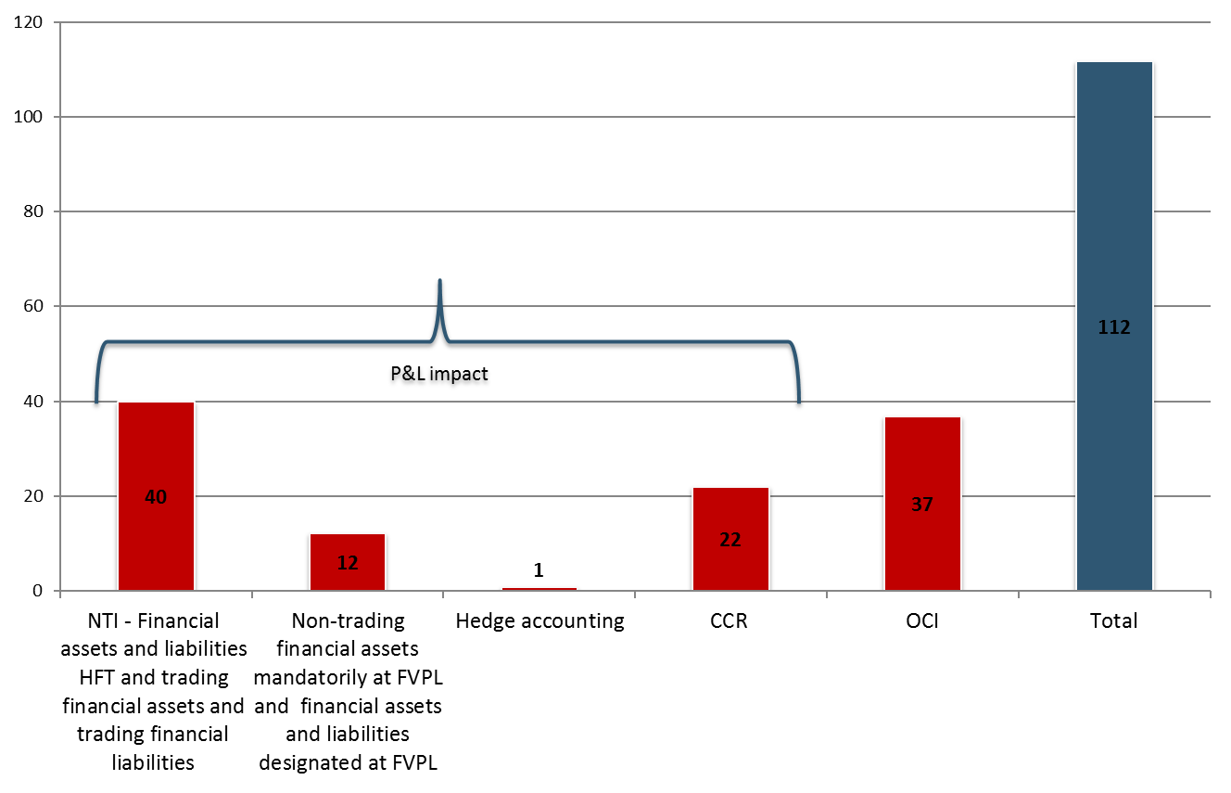
Market risk
Evolution of market risk P&L impact (€ bn)
Drivers of market risk losses in 2018
Instantaneous shock in the first year of the adverse scenario led to losses in 2018 followed by 2 years of reduced trading income. 2018 impact of -94 bn EUR (-110 bps on CET1 ratio), of which -63 bn EUR (-75 bps) are recognised in P&L and the rest through OCI.
The losses in the first year are offset by the positive income in the next years resulting in a net cumulative loss of -14 bn EUR as of end 2020.
Main drivers of MR losses in 2018: OCI (33% of total market risk impact); NTI (36% of total market risk impact ) and CCR (20% of total market risk impact).

Slide 12
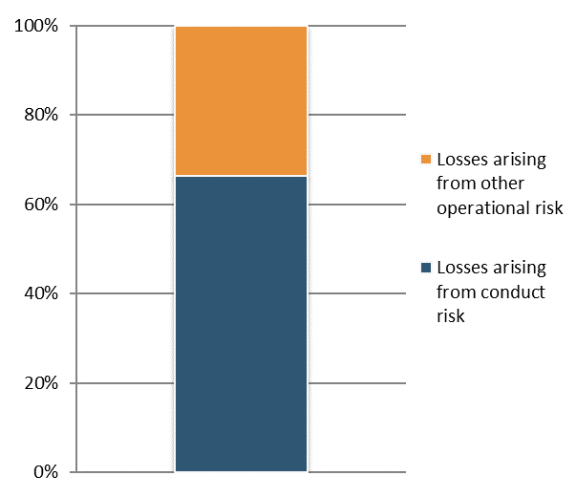
Conduct risk and other operational risk losses
Operational risk losses(€ bn)
Breakdown conduct risk and other operational risk (%)
Aggregate cumulative operational risk losses in the adverse scenario are 82bn EUR. Conduct risk losses account for 54bn EUR, the remaining amount is composed of projected losses classified as other operational risk.
Banks projected the largest volumes of losses in 2018.

Slide 13
Total REA
Total REA increase by 12% as of end 2020, with a capital impact of 160bps.
The main driver of the increases come from credit risk IRB portfolios.

Slide 14
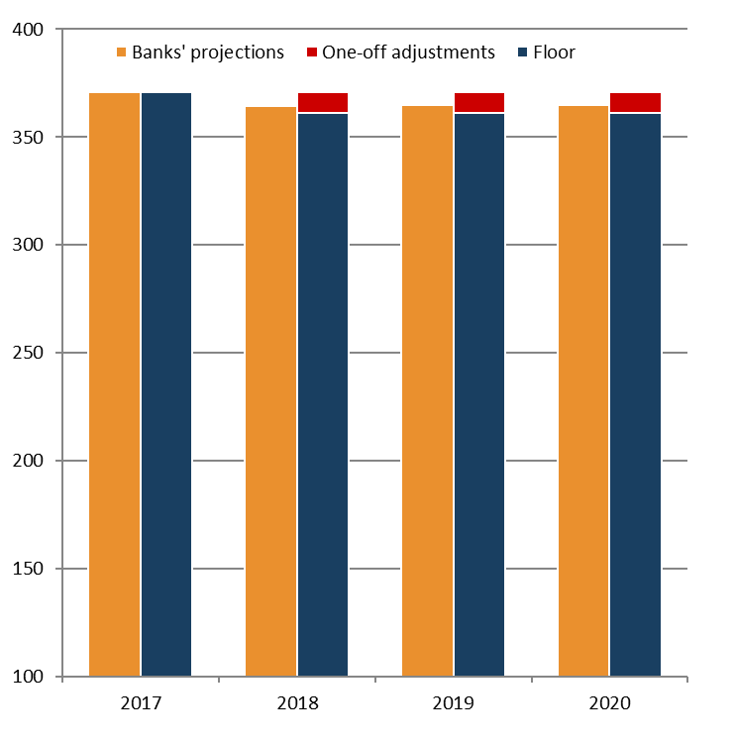
Administrative expenses, other operating expenses , other provisions and depreciation
Evolution of admin expenses, other operating expenses, other provisions and depreciation (EUR bn)
The methodology requires banks to project administrative expenses, other operating expenses, depreciation and other provisions or reversal of provisions floored at the starting level. Only adjustments coming from one-off costs approved by the EBA BoS can be applied.
23 banks adjusted their cost projections based on one-off events.
On a cumulative basis, the reduction over the three years due to one-offs was EUR 29bn with an impact on CET1 of 35bps. Banks projected expenses above the floor once this was adjusted with the one-offs.

Slide 15
Summary of impacts - Key results, aggregate EU level

