Slide 1
Changes in the Cost of Bank Equity and the Supply of Bank Credit
By C. Célérier, T. Kick and S. Ongena
EBA 5th Policy research Conference
28-29 November 2016
Comments by Olivier de Bandt (*)
(*) Discussions with Mathias Lé are gratefully acknowledged

Slide 2
Summary and main findings
1. Crucial challenges for financial stability: improving our knowledge regarding the relation between bank’s capital and bank’s lending.
What are the recent contributions in this field?
  Capital requirements and lending : Aiyar et al. (2014), Fraisse et al. (2015), Jimenez et al. (2016), Behn et al. (2016)
  Leverage ratio and lending? No much work on this subject until now
This paper is one of the first to examine the specific role of the cost of equity
  It uses “natural experiments” (ACE) in two distinct countries (BE&IT) to assess to which extent a decrease in the (relative) cost of capital affects (i) bank capital and then (ii) bank lending
2. Mechanisms and identification strategy
Reducing the cost of equity has three potential effects (according to the paper) :
  income effects : cost saving are additional resources to lend
  “cost of funds”: lower funding cost then translate into loan rates
  capital structure : relaxation of capital constraint by increasing equity
Important ingredient of the empirical setting of the paper :
  use legislative change regarding capital in IT or BE to assess change in lending in DE
  this prevent endogenous changes in legislation !
3. Main Findings of the paper
Reforms induce an increase in bank capital in both countries (the reverse is also true)
Treated banks expand lending (abroad) relatively more when the cost of equity decreases (the reverse is also true!)
The impact of the reforms is large : Italian and Belgian banks increase their lending by more than 40% relative to other banks

Slide 3
Discussion (1/3) –clarification questions
1. The reforms:
It is not totally clear to me what the reforms are doing (tax incidence issue= who benefits from the tax cut ? Issuer or investor?):
  IT : lower corporate taxes for notional income on equity-finance investment
  BE : notional interest on equity deducted from taxable income
It would be valuable to have a fictitious case studies (in the spirit of footnote 7) to understand in details the mechanisms at work
2. The results and the mechanisms:
The findings indicate that ACE leads to both :
  Relatively higher capital ratio (5% to 20%)
  Relatively higher lending volume abroad (50% to 70%)
A bit puzzling because most of the literature (cited above) find that higher capital ratios are generally associated with lower lending
  The paper could gain by discussing more these results and linking them to the three distinct channels mentioned in the introduction
  Say differently, at this stage the paper uncovers interesting effects but it is a bit short on how they work precisely
The magnitude of the effects are quite sizeable:
  For instance, in the firm level specification you find a 60% relative increase in lending by firms borrowing from at least one Italian firm
  Maybe banks cut and expand much more dramatically abroad than at home, but these figure are striking

Slide 4
Discussion (2/3) – suggestions
We don’t expect all the banks to react in the same way:
  banks which are initially more constrained by regulation should react more to the reforms
  this suggests to interact the treatment dummy with pre-reform capital ratio
Regarding the mechanisms discussed, there could be an indirect “cost of fund” channel:
  In your view, the direct channel is related to the “lower total cost of equity”
  But as Admati et al. (2013) underline, when banks increase their capital ratio, it makes the whole debt less risky and thus cheaper
  You could test this effect by looking at the effect of ACE on the interest expenses of banks.

Slide 5
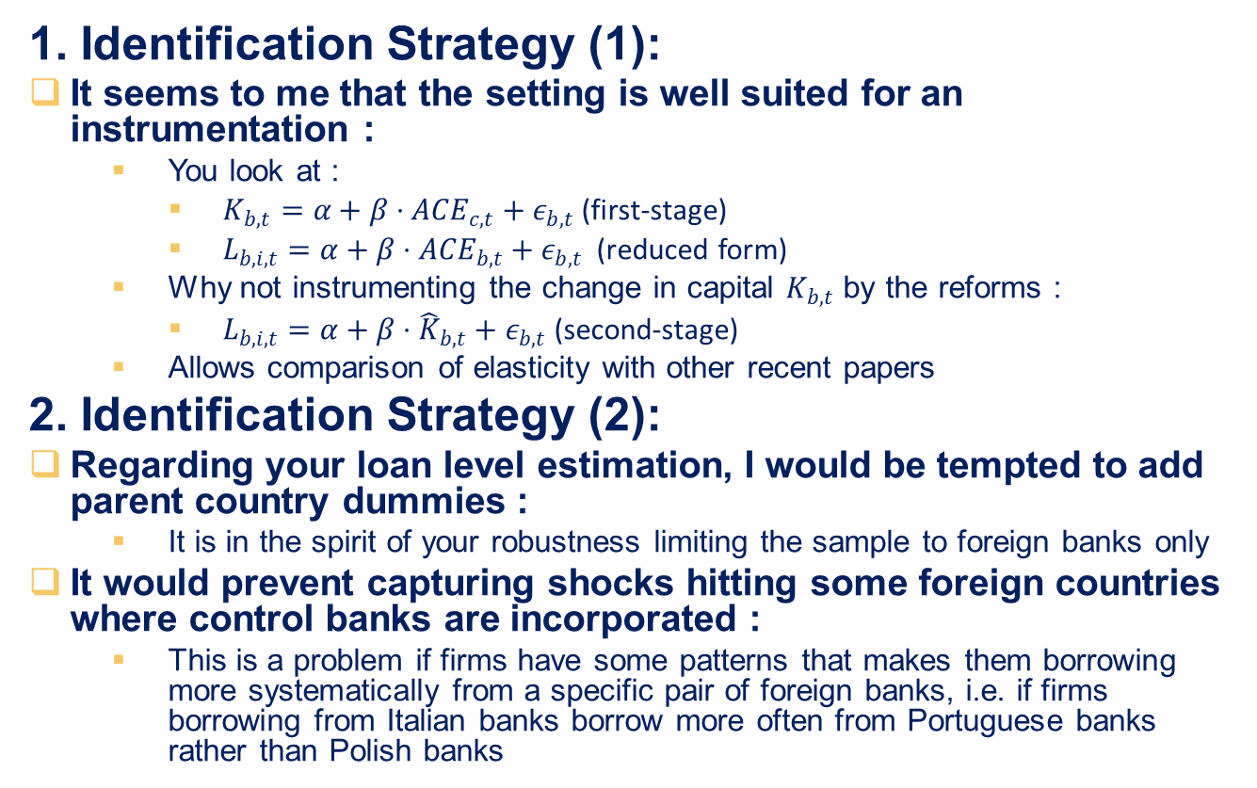
Discussion (3/3) – suggestions
1. Identification Strategy (1):
It seems to me that the setting is well suited for an instrumentation :
  You look at :
    $K_{b,t}=α+β⋅{ACE}_{c,t}+ε_{b,t}$ (first-stage)
    $L_{b,i,t}=α+β⋅{ACE}_{b,t}+ε_{b,t}$ (reduced form)
  Why not instrumenting the change in capital $K_{b,t}$ by the reforms :
    $L_{b,i,t}=α+β⋅{\hat{K}}_{b,t}+ε_{b,t}$ (second-stage)
  Allows comparison of elasticity with other recent papers
2. Identification Strategy (2):
Regarding your loan level estimation, I would be tempted to add parent country dummies :
  It is in the spirit of your robustness limiting the sample to foreign banks only
It would prevent capturing shocks hitting some foreign countries where control banks are incorporated :
  This is a problem if firms have some patterns that makes them borrowing more systematically from a specific pair of foreign banks, i.e. if firms borrowing from Italian banks borrow more often from Portuguese banks rather than Polish banks

