Slide 1
Validation rule files – Post-Transition period

Slide 2
EBA Validation rules Excel file format
During the transition period, for releases 4.0 and 4.1, the validation rules are listed and published in a separate Excel file.
Starting from release 4.2, as the transition period ends, we will maintain two validation rule Excel files going forward:
Old EBA validation rules (old grammar) — for modules produced before release 4.0.
EBA validation rules (new grammar) — for modules produced from release 4.0 onward.
Each row represents the application scope of a validation rule

Slide 3
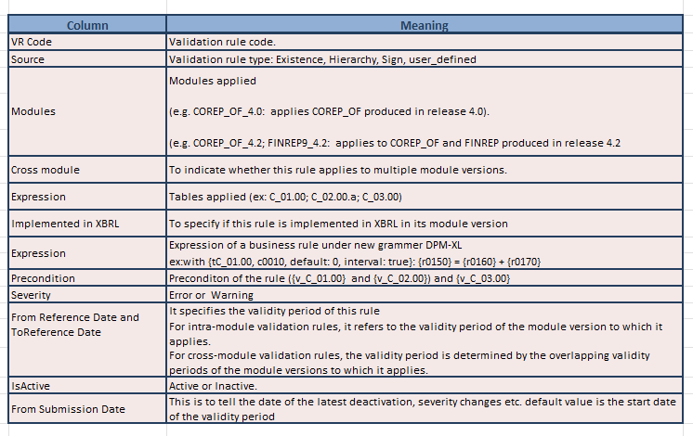
EBA Validation rules file from release 4.0

Slide 4
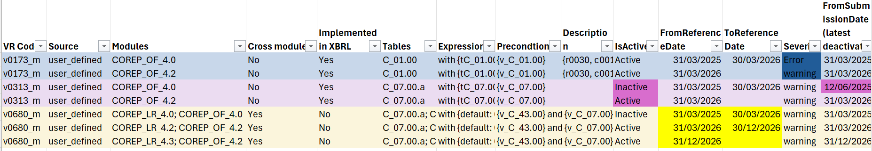
EBA Validation rules Excel file example
Case 1 – Different Severity (v0173_m)
• Same rule, different module versions • COREP_OF_4.0 → Error • COREP_OF_4.2 → Warning ✓ Severity depends on the module version
Case 2 – Different Status & Dates (v0313_m)
• Active for one module, inactive for another • FromSubmissionDate ≠ FromReferenceDate ✓ Indicates the latest deactivation date
Case 3 – Cross-Module Validation (v0680_m)
• Rule applies across multiple modules • FromReferenceDate & ToReferenceDate ✓ Represent cross-validity period

Slide 5
Thank you!

