Slide 1
Searching and switching in retail banking
Stefano Callari, Alexander Moore, Laura Rovegno
Competition and Markets Authority†
Pasquale Schiraldi
London School of Economics
† Although the authors worked on certain aspects of the retail banking market investigation at the UK Competition and Markets Authority (CMA), the views and opinions expressed in this paper are the sole responsibility of the authors and do not necessarily reflect those of the CMA or the inquiry group.

Slide 2
Introduction
What factors drive customers to search for or switch to a new current account?
The research was conducted as part of the CMA’s official market inquiry into the retail banking market.
The data we used are a combination of transactions data on retail banking customers and their responses to a detailed telephone survey.
We estimate a bivariate recursive probit model in which:
  the decisions to search and to switch are modelled jointly; and
  the decision to search directly influences the decision to switch.

Slide 3
Motivation
This analysis asks why people are (dis)engaged.
    What factors are associated with searching and switching?
    How do the two variables interact?
Low searching or switching rates might indicate low customer engagement
    The (threat) of switching is a “disciplining” mechanism
    With low threat, the incentive to compete is weakened
It is difficult for new entrants and smaller providers to expand organically.
    Competitive constraints are weakened
Increased regulatory focus on demand side factors

Slide 4
Data
Customer-level monthly transaction data on 120,000 customers from all major UK banks in 2014. The data included information on:
  average credit and overdraft balance
  value of payments and transfers into the account
  number of days in credit and in arranged or unarranged overdraft
  number of mobile banking app and internet banking logins
  number of direct debits and standing orders
Telephone survey with 4,549 respondents, oversampling switchers due to their small number. The survey included information on:
  whether customers searched or switched for a new current account
  general customer demographics (age, gender, income, educational qualification, working status)
  customers' financial literacy and confidence in using internet
  ‘trigger’ factors (eg whether customers recently moved house or changed marital/living arrangements)

Slide 5
Searching and switching
Customers are categorised as searchers if they responded that they had looked around at least once for a new current account.
  “In the last three years have you looked around to see what different accounts are available?“
Analogously, they are categorised as switchers if they had switched their main current account to a different bank.
  “Have you changed your main current account in the last three years?”
We focussed on customers who have searched for or switched to a new current account in the last 12 months and:
  we excluded from the analysis:
    customers who responded that they had searched or switched in the last two to three years; and
    customers who responded that they had switched accounts within the same bank.
  our reference group is made of :
    customers who did not search for or did not switch to a new current account at all; or
    customers who have not switched accounts within the same bank.

Slide 6
Descriptive statistics
Groups | Proportion of surveyed sample (weighted, %) | Number of observations (unweighted, N)
Non-searcher/non-switchers | 65.4 | 2779
Searcher/non-switchers | 14.2 | 574
Searcher/switchers | 2.3 | 208
Non-searcher/switchers | 0.8 | 115
Excluded* | 17.4 | 873
 | 100 | 4,549
* Notes:
  1. We exclude from the analysis customers who responded that they had searched or switched in the last two to three years, as well as those who responded that they had switched accounts within the same bank.
  2. Our ‘reference group’ is the group of customers who have not searched or switched at any point in the last three years, and who have not switched accounts within the same bank.

Slide 7
Descriptive statistics

Slide 8
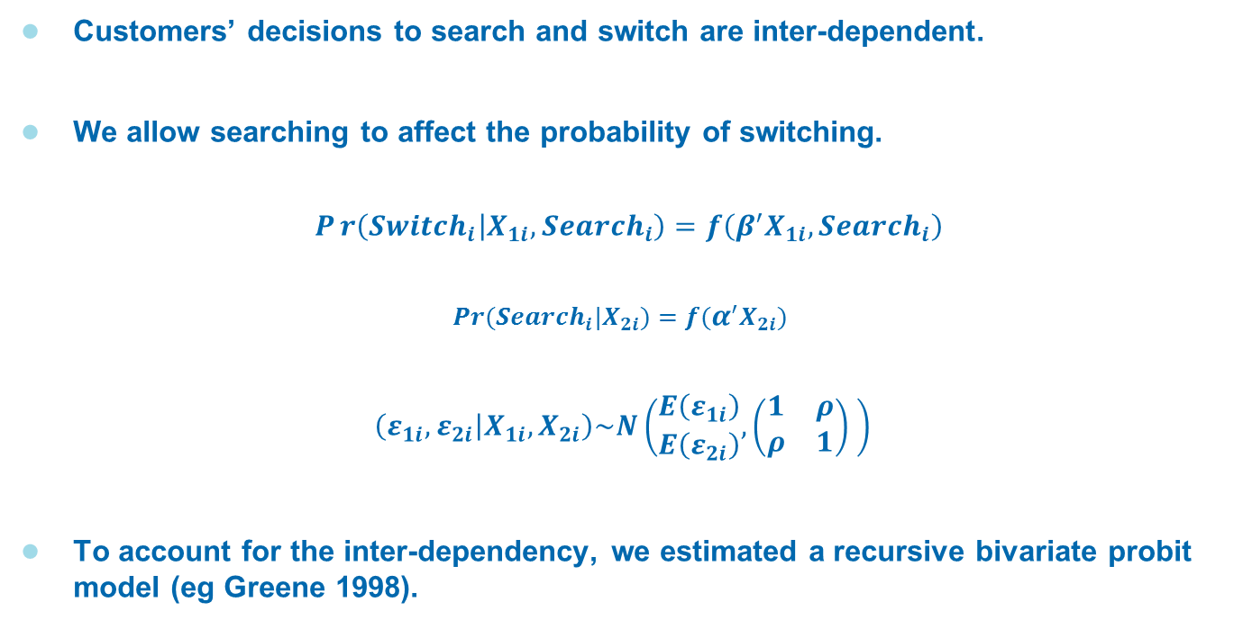
Methodology
Customers’ decisions to search and switch are inter-dependent.
We allow searching to affect the probability of switching.
$$Pr\left({Switch}_{i} | X_{1i},{Search}_{i}\right)=f\left({β^{′}X}_{1i},{Search}_{i}\right)$$
$$Pr⁡({Search}_{i}|X_{2i})=f(α^{′}X_{2i})$$
$$\left(ε_{1i},ε_{2i} | X_{1i},X_{2i}\right)\sim N\left(\begin{matrix}E\left(ε_{1i}\right) \\ E\left(ε_{2i}\right)\end{matrix},\left(\begin{matrix}1 & ρ \\ ρ & 1\end{matrix}\right) \right)$$
To account for the inter-dependency, we estimated a recursive bivariate probit model (eg Greene 1998).

Slide 9
Variables affecting searching affect switching through two channels:
  (a) Direct
  (b) Indirect (via search)
The recursive structure allows us to estimate both.
Univariate structure
Recursive structure
indirect
Switch
4%
direct
Switch
0%
Branch closure
Branch closure
Search
9%
Search
9%

Slide 10
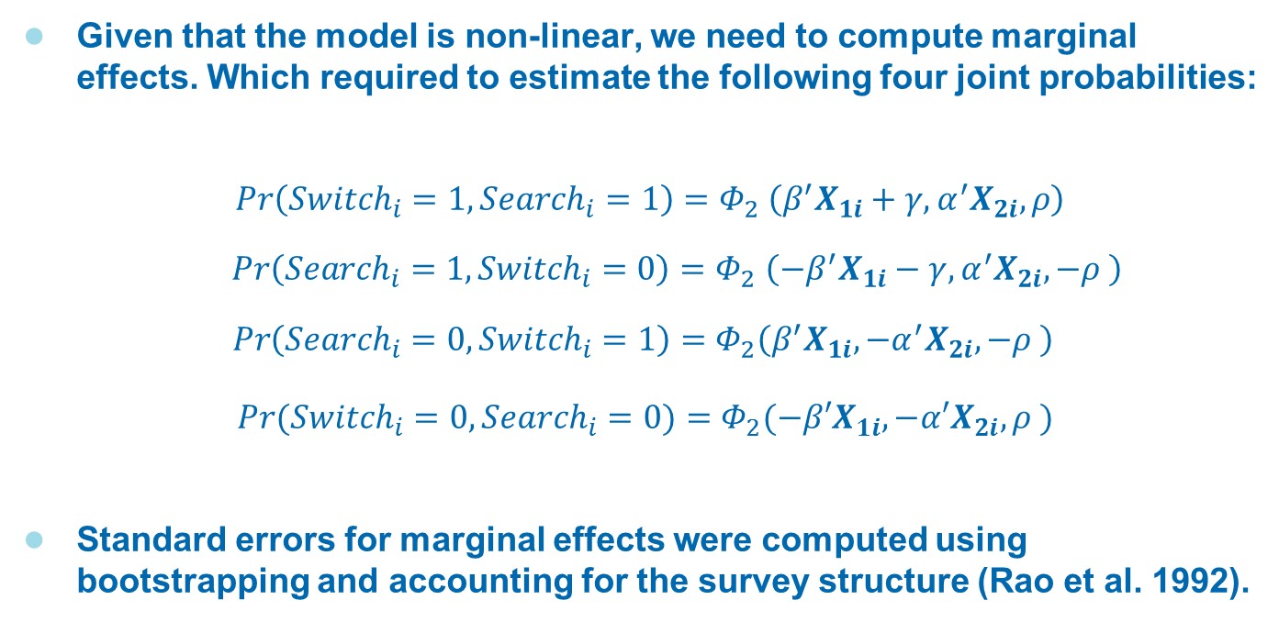
Marginal Effects
Given that the model is non-linear, we need to compute marginal effects. Which required to estimate the following four joint probabilities:
$$\operatorname{Pr}\left({Switch}_{i}=1,{Search}_{i}=1\right)=Φ_{2} \left(β^{′}X_{1i}+γ,α^{′}X_{2i},ρ\right)$$
$$\operatorname{Pr}\left({Search}_{i}=1,{Switch}_{i}=0\right){=Φ}_{2}\left(−β^{′}X_{1i}−γ,α^{′}X_{2i},−ρ \right)$$
$$\operatorname{Pr}\left({Search}_{i}=0,{Switch}_{i}=1\right)=Φ_{2}\left(β^{′}X_{1i},−α^{′}X_{2i},−ρ \right)$$
$Pr⁡({Switch}_{i}=0,{Search}_{i}=0)=Φ_{2}(−β′X_{1i},−α′X_{2i},ρ )$
Standard errors for marginal effects were computed using bootstrapping and accounting for the survey structure (Rao et al. 1992).

Slide 11
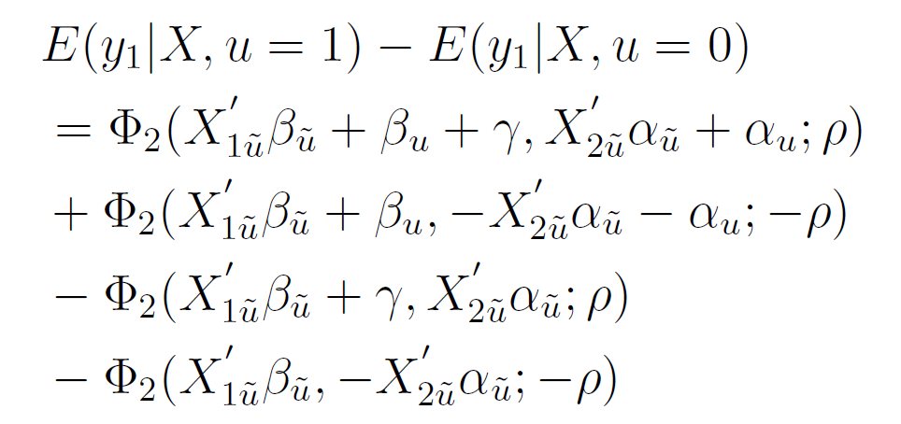
Marginal Effects (Discrete variables)

Slide 12
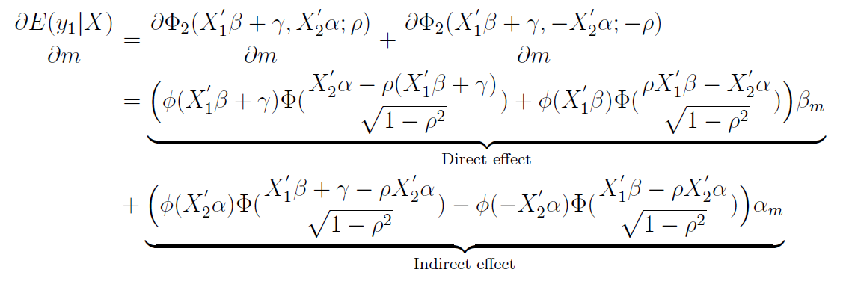
Marginal Effects (Continuous variables)

Slide 13
Results (Searching)
 |  | Coefficients | Marginal effects
Customer demographics | Income below 24,000£ | -0.157** (0.0732) | -0.041** (0.194)
 | Degree | 0.114* (0.066) | 0.030* (0.017)
 | Financial literacy | 0.192*** (0.067) | 0.050*** (0.016)
Use of internet | Internet confidence | 0.560*** (0.102) | 0.126*** (0.003)
 | No internet banking | -0.183** (0.080) | -0.047** (0.020)
 | No bank mobile app | - | -
Monetary features | Number of transactions | -0.003** (0.001) | -0.001* (0.000)
 | Overdraft user | -0.038 (0.073) | -0.010 (0.019)
 | High credit balance | 0.195** (0.078) | 0.053* (0.022)
Bank of origin | Large bank | -0.133** (0.066) | -0.036* (0.019)
Trigger factors | Local branch closed | 0.304*** (0.112) | 0.088** (0.036)
 | Changed work status | 0.189** (0.084) | 0.052** (0.026)
Observations |  | 3,502
Notes:
We also controlled for age groups and gender.
*** p<0.01, ** p<0.05, * p<0.1. Standard errors in parentheses.

Slide 14
Results (Switching)
 |  | Coefficients | Marginal effects | Direct effect | Indirect effect
Searching |  | 0.154*** (0.526) | 0.116*** (0.014)
Customer demographics | Income below 24,000£ | -0.095 (0.104) | -0.013* (0.006) | -0.006 | -0.007
 | Degree | -0.167* (0.091) | -0.006 (0.006) | -0.011 | 0.005
 | Financial literacy | -0.021 (0.096) | 0.006 (0.002) | -0.001 | 0.008
Use of internet | Internet confidence | -0.164 (0.139) | 0.010* (0.005) | -0.013 | 0.022
 | No internet banking | - | -0.007 (0.004) | - | -0.007
 | No bank mobile app | -0.210** (0.096) | -0.014** (0.007) | -0.014 | -
Monetary features | Number of transactions | -0.004** (0.002) | -0.000** (0.000) | -0.000 | -0.000
 | Overdraft user | -0.208** (0.102) | -0.014** (0.005) | -0.012 | -0.002
 | High credit balance | 0.117* (0.110) | 0.017* (0.008) | 0.009 | 0.008
Bank of origin | Large bank | -0.101 (0.101) | -0.013* (0.007) | -0.007 | -0.006
Trigger factors | Local branch closed | 0.100 (0.158) | 0.022 (0.015) | 0.009 | 0.013
 | Changed work status | - | 0.008* (0.005) | - | 0.008
Observations |  | 3,502
Notes:
We also controlled for age groups and gender.
*** p<0.01, ** p<0.05, * p<0.1. Standard errors in parentheses.

Slide 15
Main results (Searching)
Overall, we find much stronger results regarding the drivers of searching than for switching
The main drivers of searching are:
  Confidence in the use of internet, which is probably associated with reduced searching and switching costs when shopping around online.
  Education and financial literacy
  Holding high credit balances, which is probably associated with having more to gain from pull factors such as higher interest rates or cashbacks.
  The closure of a local branch

Slide 16
Main results (Switching)
Searching appears the sole most important driver for switching
  Searchers are 12 percentage points more likely to switch than non-searchers.
Conditional on searching, most drivers considered are not significant determinants of switching
Only exception: overdraft users, as they are less likely to switch conditional on searching
  Although overdraft users could potentially realise higher monetary gains by switching accounts, this does not translate in higher level of engagement.

