Slide 1






What Drives the Expansion of the Peer-to-Peer Lending?
Olena Havrylchyk (University of Lille, LEM, CEPII)
Carlotta Mariotto (École des Mines de Paris)
Talal-Ur- Rahim (Boston University)
Marianne Verdier (University of Paris 2, CRED)
Notes:
Un nouveau phénomène de l’innovation financière.
Innovation n’est pas toujours bien vue dans la finance. Au contraire, l’innovation est souvent perçu comme un moyen de l’arbitrage règlementaire.
La dernière innovation utile dans la finance était un distributeur de la monnaie.
Pourtant, aujourd'hui on observe un nouveau type de l’intermédiation financière: finance participative; finance alternative; finance démocratique, finance sociale, crowdfunding, peer-to-peer lending.
Une technologie disruptive?
Perturber les banques ou financement de niche?
Future est difficile à prévoir, mais on peut déjà examiner les causes de la diffusion de la finance participative.
On le fais avec les données américaines, car c’est un des marchés de la finance participative le plus développée.

Slide 2
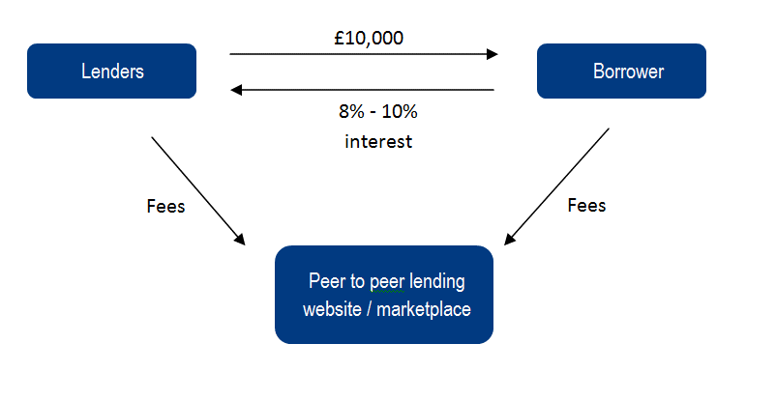
“Banking is necessary; banks are not”
Bill Gates, 1990
P2P/marketplace lending is a new form of (dis)intermediation
Prosper: variable rate model (Dutch auction) from 2006 to 2009 and fixed interest rate afterwards.
Lending Club: fixed interest rate

Slide 3
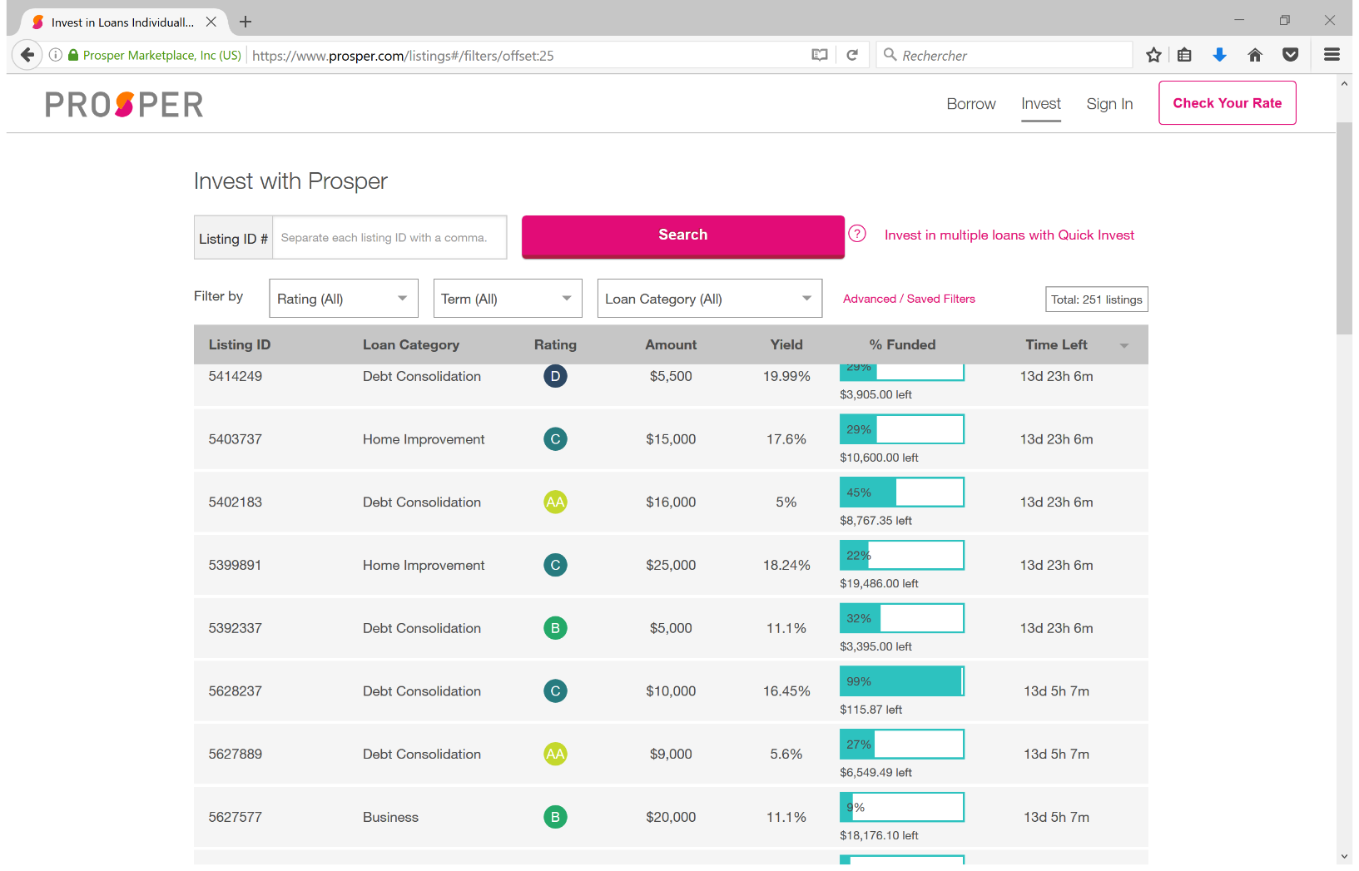

Slide 4
Borrowers use P2P platforms mostly for debt consolidation
A typical borrower is a wealthy individual with high level of debt (Morse, 2016)

Slide 5
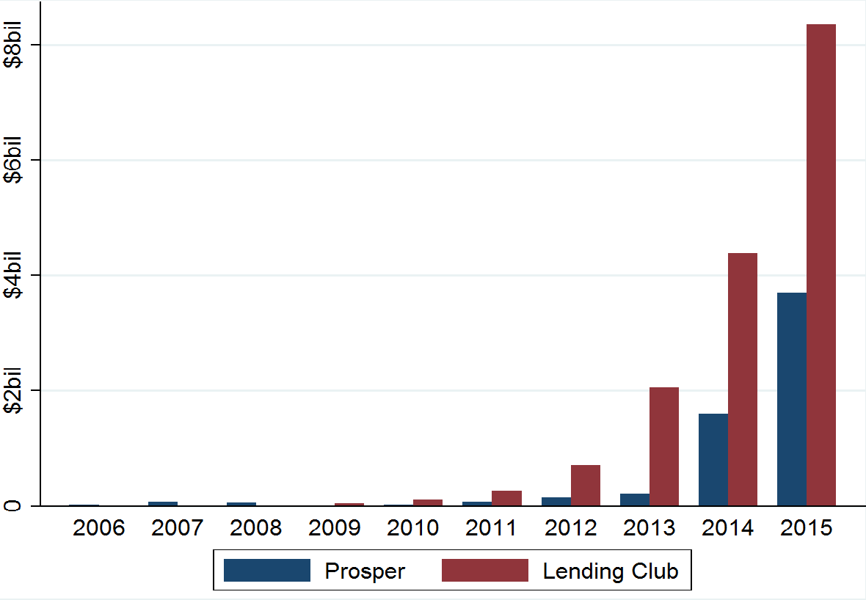
P2P lending growth in the US (in billions of dollars)
Launch of P2P lending platforms in 2006 (Prosper) and 2007 (LC)
Prosper and LC closed in 2008 due to the regulatory uncertainty (selling of unregistered securities) and litigation
In 2008-2009, platforms reopen after SEC registration.
2012 and 2014: LC and Prosper become profitable
2014: LC goes public

Slide 6
How important is P2P lending?
Very small in % of total bank lending
But in some niche markets, it becomes very important.
  In 2015, the US online alternative finance consumer lending was equivalent to 12.5% of traditional consumer lending (Wardrop et al., 2016).
  In 2015, 12% of UK small business loans and 16% of venture and seed capital came from P2B and equity crowdfunding platforms (Wardrop et al., 2016).

Slide 7
P2P vs traditional banks
Borrowers’ perspective: final product is the same – a loan.
Lenders’ perspective: platforms and banks do not offer the same services
  No liquidity provision
  No delegated monitor
Banks enjoy ↓ funding costs due to explicit and implicit govt. guarantees
P2P platforms use new technology to ↓ operating costs and to price risks and do not have legacy problems, aggravated by the crisis
In 2016, Zopa has applied for a banking license.
Notes:
Fournisseur de la liquidité
Contrôleur délégué
Tarification du risque
certains problèmes hérités.

Slide 8
What are the main drivers of the expansion of the P2P lending?
H1: Competition-related hypothesis

Slide 9
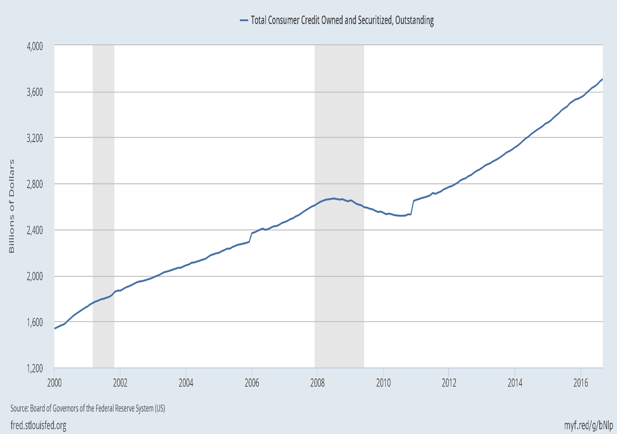
What are the main drivers of the expansion of the P2P lending?
H1: Competition-related hypothesis
H2: Crisis-related hypothesis

Slide 10
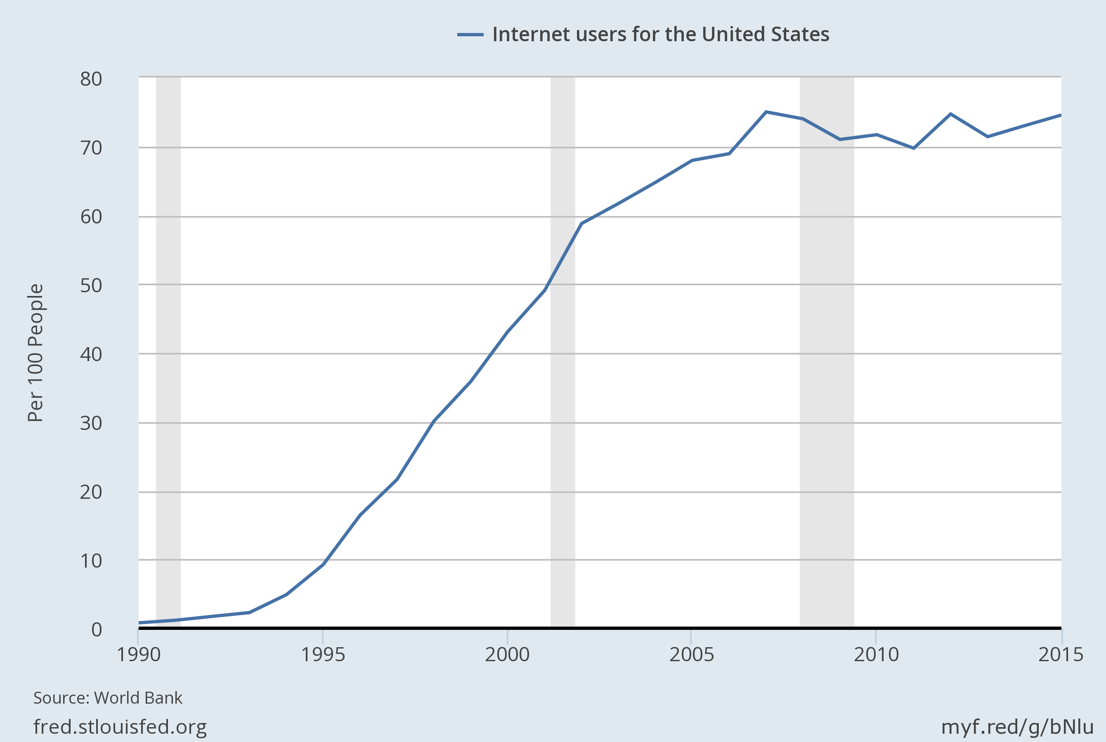
What are the main drivers of the expansion of the P2P lending?
H1: Competition-related hypothesis
H2: Crisis-related hypothesis
H3: Technology-related hypothesis

Slide 11
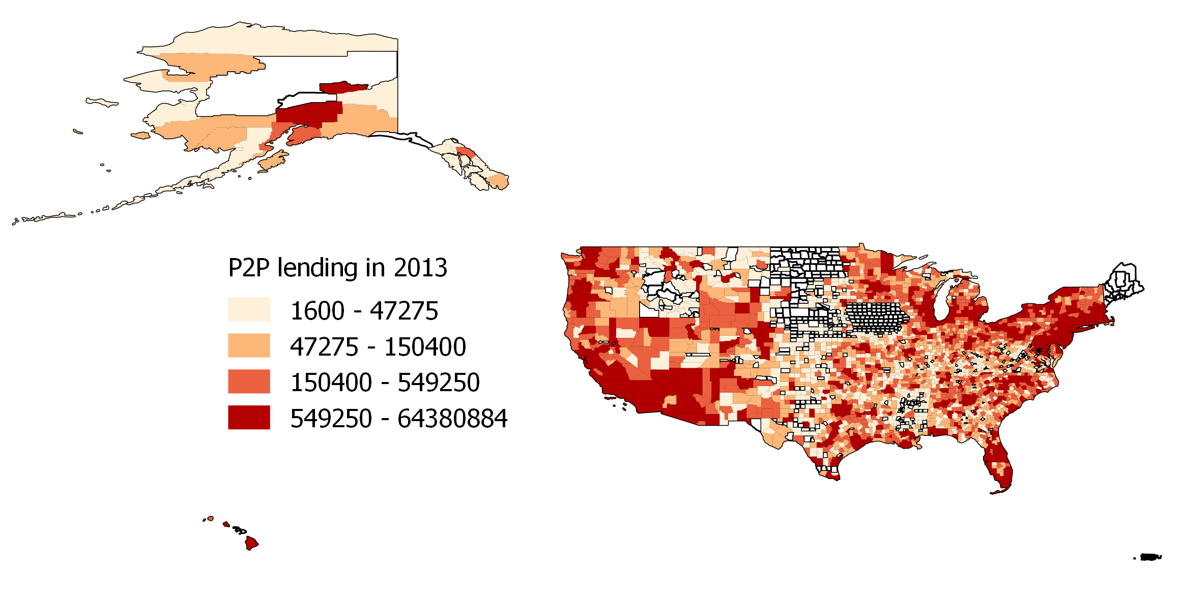
Identification strategy relies on the geographic heterogeneity

Slide 12
Main dataset: loan books of Prosper and LC
LC and Prosper transaction level data aggregated at the county level for 2006-2013
Dep. variables: (1) Volume of P2P lending; (2) N. of loans per capita
 | 2006 | 2007 | 2008 | 2009 | 2010 | 2011 | 2012 | 2013
Lending Club
Volume (in mln $) | 0 | 2 | 13 | 46 | 116 | 257 | 718 | 2064
N. of counties | 0 | 110 | 379 | 676 | 987 | 1359 | 1836 | 2384
N of. Loans | 0 | 246 | 1488 | 4500 | 10594 | 19861 | 49811 | 137824
ProsperProsper
Volume (in mln $) | 29 | 81 | 69 | 9 | 27 | 75 | 154 | 217
N. of counties | 673 | 1175 | 1377 | 631 | 1029 | 1397 | 1739 | 1721
N. of loans | 6145 | 11592 | 11683 | 2118 | 5864 | 11508 | 20054 | 21990
Notes:
Par habitant

Slide 13
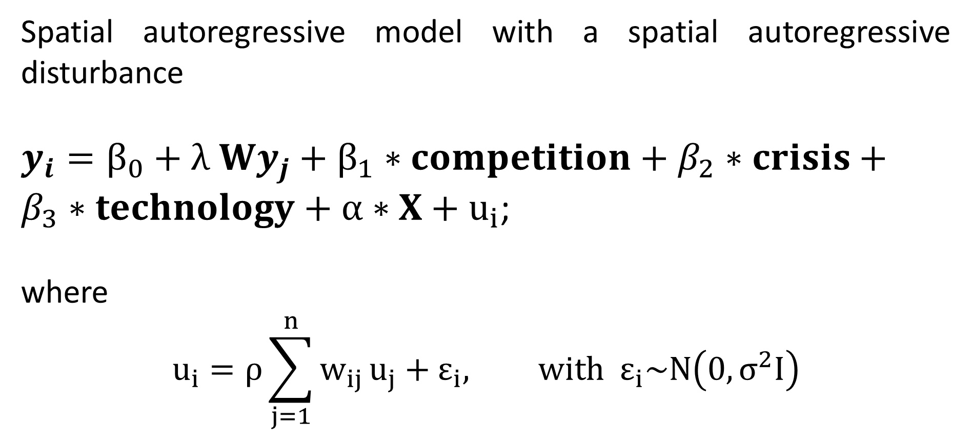
Estimation with SARAR model
Spatial autoregressive model with a spatial autoregressive disturbance
$y_{i}=β_{0}+λ Wy_{j}+β_{1}∗competition+β_{2}∗crisis+β_{3}∗technology+α∗X+u_{i}$;
where
$$u_{i}=ρ\sum_{j=1}^{n}{w_{ij}}u_{j}+ε_{i}, with ε_{i}\sim N\left(0, σ^{2}I\right)$$

Slide 14
Does geography explain P2P lending?
Various channels of spatial interdependence
Theory of human interactions (Comin et al., 2012) and technology diffusion
Regional business cycles and economic shocks
Policy coordination
Boundary mismatch problems when the economic notion of a market does not correspond well with the county boundaries (Rey and Montouri, 1999).
Regional disparities for which we do not control with our right-hand variables

Slide 15
Measuring the depth of the crisis
Failed banks: % of deposits affected by bank failures in a county
Crisis Leverage: The average leverage ratio of deposit taking institutions present via branches in a county, during crisis years
Crisis Tier 1 capital: The average Tier A capital ratio of deposit taking institutions, during crisis years
Credit rationing: change in Credit Card Debt Balance per Capita during crisis years
Delinquencies: % of Credit Card Debt Balance 90+ Days Delinquent during crisis years
Notes:
Comment mesurer l’ambleur de la crise?
Signe positive!

Slide 16
Measuring competition by market structure
HHI: Herfindahl-Hirschmann index, computed in terms of deposits
C3: The share of deposits of the three largest deposit taking institutions in a county
Branches per capita: Number of branches in a county divided per 10 000 population
Pay Day loans: Number establishment divided by 10 000 population.
Notes:
fidélité à la marque
Les agences pour fideliser
Branches per capita:
la Signe?

Slide 17
Measuring technology
Broadband: % of county population with access to any broadband technology (excluding satellite)
Mobile: % of county population with access to Mobile Wireless (Licensed) technology
Speed: % of county population with access to upload speed 50 mbps or higher
Patents: Number of patents per 10 000 population
Notes:
à haut débit
Brevets déposés

Slide 18
Controlling for socio-economic characteristics
Age 20 to 34: The share of the population between 20-34 years
Population density: Population number divided by area in sq. m. in a county
Bachelor: % of county population with at least bachelor education
Poverty: % of county population below poverty line
Black: % of Afro-Americans in the county population
Hispanic: % of Hispanic population in the county population
Asian: % of Asian population in the county population
State level dummies

Slide 21
Conclusions:
What are the main drivers of the P2P lending?
Low level of branch density and banking concentration
  Due to lower presence of traditional banks and lower brand loyalty?
Presence of educated, innovative and wealthy population
Presence of ethnic minorities (black and hispanic)
  Due to discrimination by traditional bank?
Spatial diffusion plays an important role
Neither crisis variables nor internet matter

