Slide 1
Competition and the riskiness of banks’ loan portfolios
By Nielsen, Sorgard, Heimdal and Solberg
Discussion by Matteo Aquilina
(opinions mine, not of the FCA)

Slide 2
Summary of the paper
Theoretical and empirical contribution to the literature on competition and stability in banking. Highly relevant to the conference and to Policy Making in general.
Theory, main contribution: dampened competition can increase the risk taken by banks on the borrowers’ side (higher margin -> bank will serve riskier borrowers)…but other models in the literature suggest the opposite (franchise value).
Empirics, main contribution: there is a U-shaped relationship between concentration and riskiness (measured by NPLs). In Norway, current levels of concentration look approximately optimal.

Slide 3
Some general suggestions…
Do you really need the theoretical model?
In your model there is a linear relationship between riskiness and competition. You refer to Martinez-Miera and Repullo (2010) who develop a model where the U-shaped relationship is present. This provides the theoretical underpinnings for your empirical strategy and the inclusion of a quadratic term in the regression analysis.
Pick one among “competition” and “concentration” and one among “stability” and “riskiness” and stick to it.
It is sometimes difficult to follow the reasoning as the direction of the effects you are discussing depends on which specific term you are using.

Slide 4
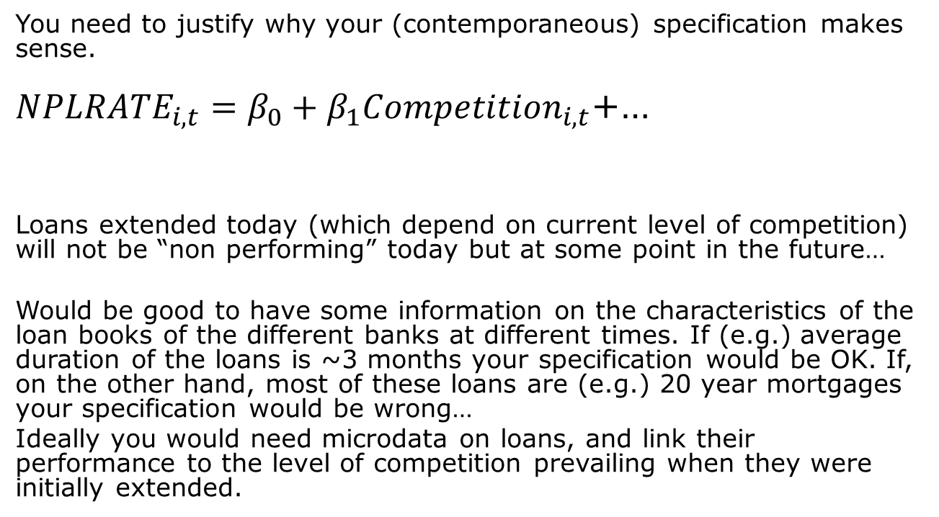
…my main comment.
You need to justify why your (contemporaneous) specification makes sense.
${NPLRATE}_{i,t}=β_{0}+β_{1}{Competition}_{i,t}$+…
Loans extended today (which depend on current level of competition) will not be “non performing” today but at some point in the future…
Would be good to have some information on the characteristics of the loan books of the different banks at different times. If (e.g.) average duration of the loans is ~3 months your specification would be OK. If, on the other hand, most of these loans are (e.g.) 20 year mortgages your specification would be wrong…
Ideally you would need microdata on loans, and link their performance to the level of competition prevailing when they were initially extended.

Slide 5
..and a couple of others.
You exclude the ‘92- ‘94 banking crisis period, but it may be the most interesting period for your analysis as it was a manifestation of lack of stability.
I would find it interesting to know the effects of competition on riskiness in different parts of the distribution of risk:
Quantile regressions could shed light on what is driving the average changes: risky banks becoming even more risky or safe banks becoming less safe?

